Slide 1
Exploring the neighborhoods of Brooklyn based on venues and rent

Slide 2
Introduction
This report tackles with the simple idea of choosing the best neighborhood to move to in Brooklyn,NY for you depending on your budget.
It takes in the factor of availability of resources around the neighborhood be it a neighborhood with delicacies of multiple ethnicities or a one with more accessible to parks and leisure activities.
This case would be specifically useful for people moving to a neighborhood in Brooklyn but individuals can also use this case’s example and cluster any neighborhood of their choice.

Slide 3
Data Collection and Cleaning
The dataset on the New York neighborhoods and their corresponding coordinates will be mainly collected from the dataset that is readily available in the IBMDeveloperSkillsNetwork portal.
Use of Foursquare API to collect venue information.
Data extraction of rent trends in the neighborhood from the site rentcafe.
checking for missing neighborhood entries in the rent trend dataset
Adding the missing entries with mean rent of the dataset.

Slide 4
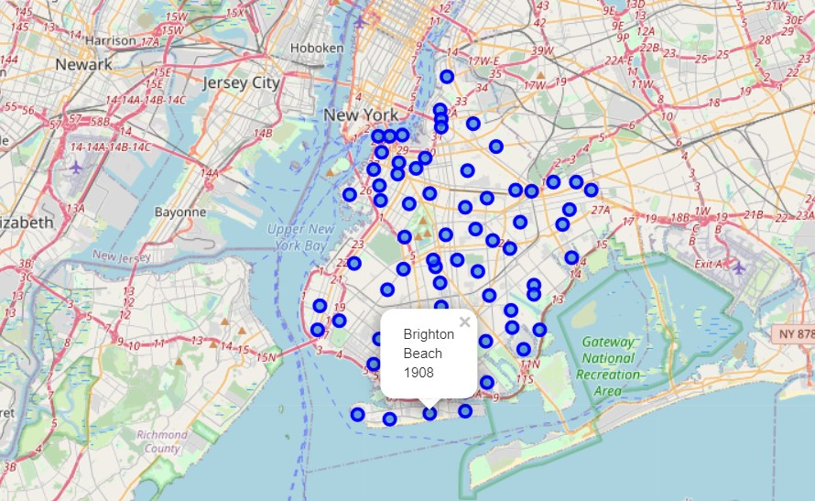
Analysis
Plotting the coordinates of the different neighborhoods in Brooklyn with circle markers at the corresponding locations.
To do this we make use of the folium library in python
We can see the map of Brooklyn,NY with markers on the each neighborhood

Slide 5
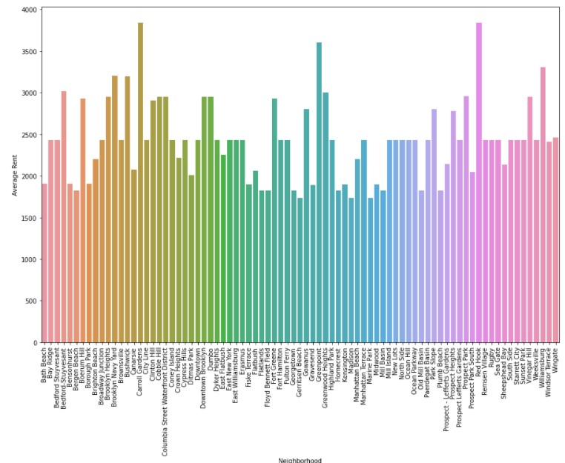
A barplot for the rent trend dataset. we can observe that Carroll Gardens has the highest amount of average rent which is something to consider for while choosing a neighborhood.

Slide 6
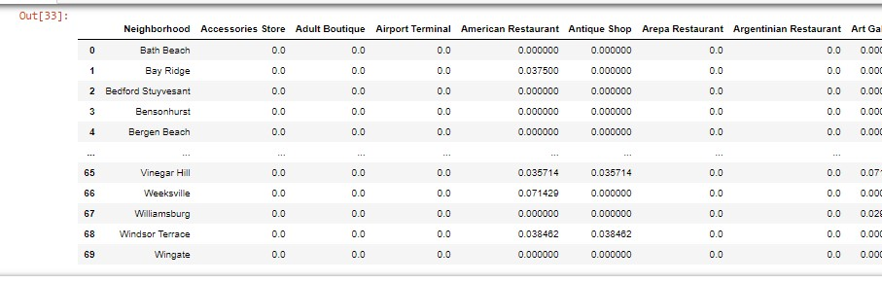
We make a new dataframe by one hot encoding the Foursquare data on its neighborhood venue's .After that we use pandas group by method to find the mean of the one hot encoded venues.

Slide 7
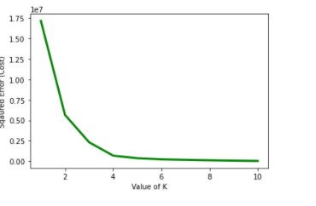
Before proceeding with k-means clustering we need to decide an optimal value for K.We do this is implementing Elbow Method.
we choose the elbow point for the graph i.e k=4

Slide 8
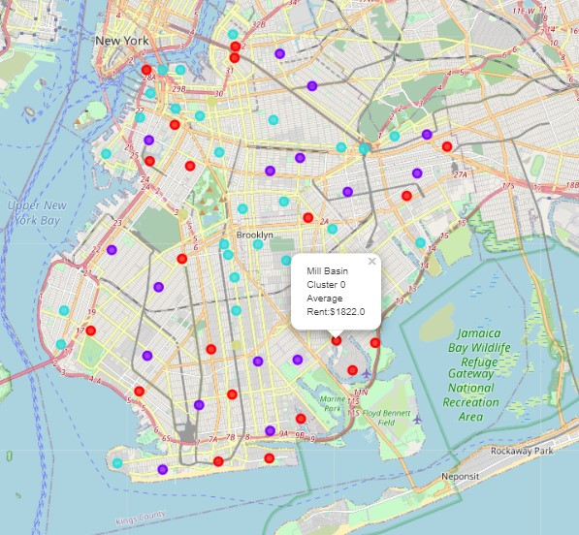
Below are the clustered neighborhoods that are grouped into 4 plotted in the map of Brooklyn. We use different colors for each cluster to make it more distinguishable

Slide 9
Result & conclusion
Cluster 0:The neighborhoods in this cluster are have the cheapest rent and mostly has all kinds of restaurants and shop for recreational activities.
Cluster 1:The neighborhoods in this cluster have rents on the higher end and is filled with diverse and multicultural restaurants. There also seem to be a lot of pubs and bars in most of the neighborhoods of this cluster. So there a vivid nightlife in this area.
Cluster 2:The neighborhoods in this cluster have mostly average rent andd is almost similar to cluster 0 in terms of venues. The only differentiator factor here is the rent
Cluster 3:The neighborhoods in this cluster have highest rent and seems like a posh area. The area has multiple jazz clubs and wine shops
Completed analysis on the different neighborhoods of Brooklyn, NY based on nearby venues and rent trends. We have used the clustered coordinates and plotted it over the map of Brooklyn. The purpose of this case was to help the individual in making a informed decision on which neighborhood to choose

